Slide 3
Pivot Script- Customer Service Script
AGENT: Hello ____________this is ____________with Keller Williams. Do you have a couple of minutes?
AGENT: The purpose of my call was to check in with you. I am making calls to my clients and everyone I know to see if there is anything I can do for you or your family?
AGENT: How are you doing? How is ( your wife, husband, kids, dogs, etc.)
AGENT: How is the company you work at doing?
AGENT: Are you able to stay home and be safe?
AGENT: This is my cell phone (provide number) please keep it and please reach out if there is anything I can help you with (need groceries, need medication picked up, etc.). I want to help. Also, if you know of anyone that is in a desperate situation please let me know and let me see what I can do to help. I may have some resources that can help.
AGENT: I am glad to speak to you and I know this will be a challenging time. Again, thank you so much for speaking with me, and please remember to call me if you need anything. I will do whatever I can to help

Slide 9
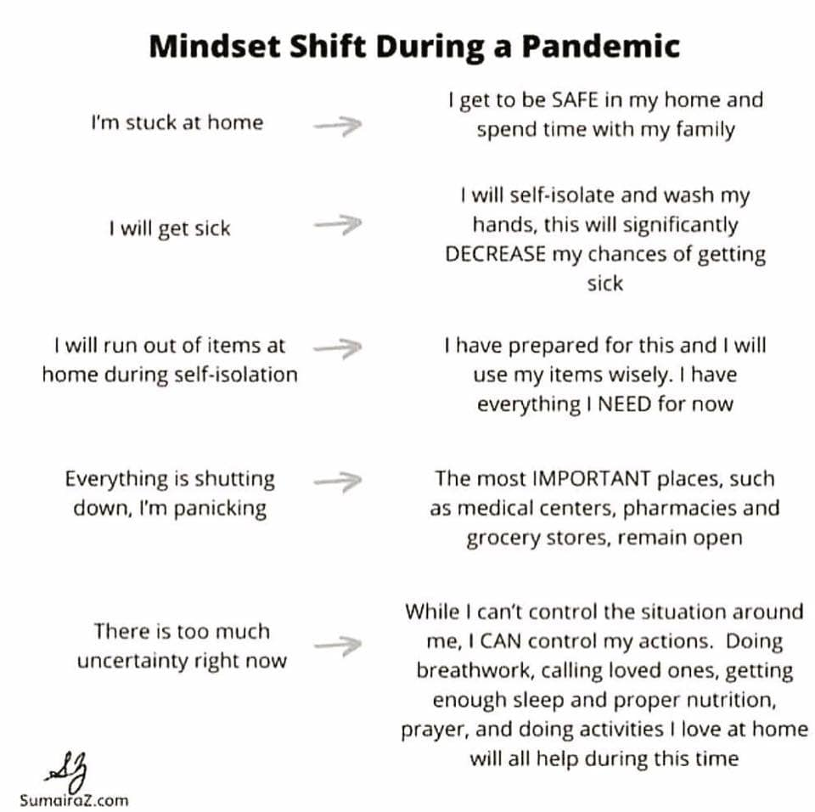

Slide 35
I truly hope that nobody will lose their home during
this period of time.
My wish is that this is a relatively quick event
over the next few months and people can seek relief from
the banks and government to get them through this hurdle.
They say what you think about, you bring about…so at this
time I choose not to think about anyone losing their home.
( but it is a chapter in the book, so had to mention)

